Slide 1
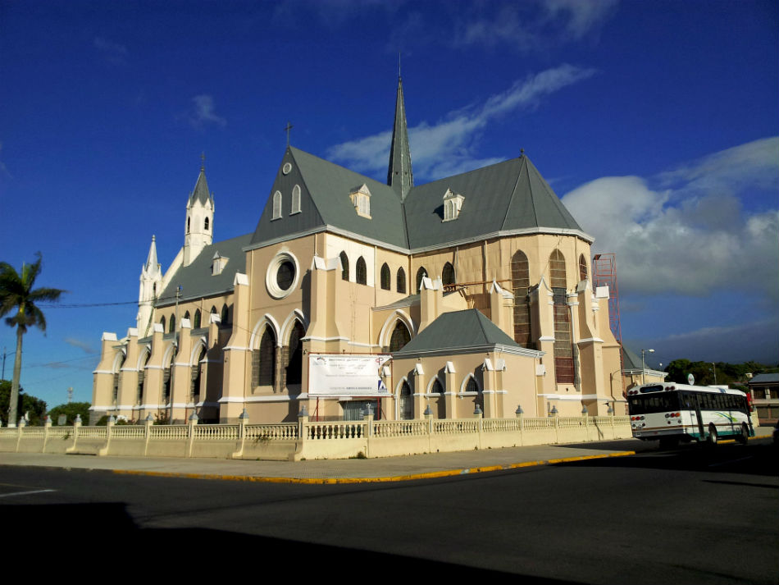
What is this?
It’s a ______________
church

Slide 2
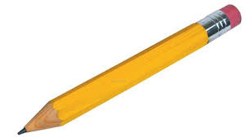
What is this? It’s a ________________
pencil

Slide 3
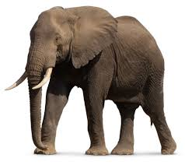
What is that? It’s an _________________
elephant

Slide 4
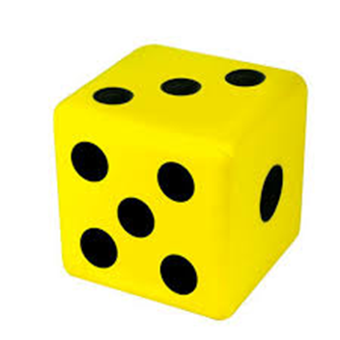
What is that? It’s a ________
die.

Slide 5
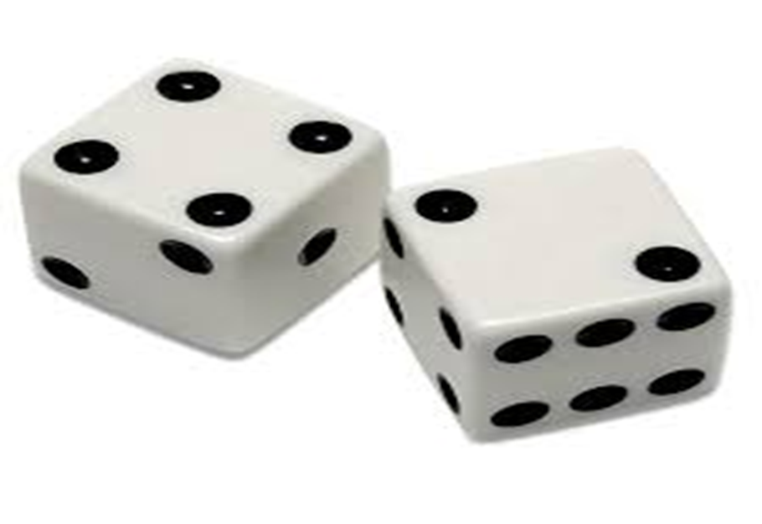
What are those?
They are _____________
dice

Slide 6
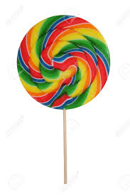
What is that?
It’s a __________________
lollipop

Slide 7
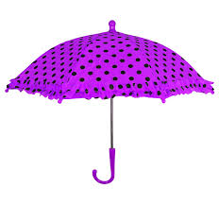
What is this? It’s an _________________
umbrella

Slide 8
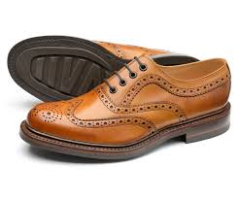
What are these?
They are __________________
shoes

Slide 9

What is that?
It’s a _______________
feather

Slide 10
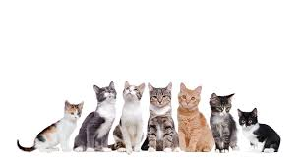
What are those?
Those are __________
cats

Slide 11
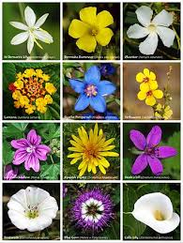
What are these?
These are______
flowers

Slide 12
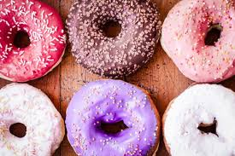
What are these?
They’re _________
donuts

Slide 13
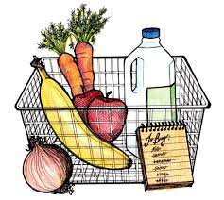
What is this?
What are those?
It’s a______
basket
Those are ______
groceries

Slide 14
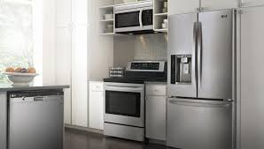
What is this?
What are those?
It’s a______
kitchen
Those are ________
appliances

Slide 15
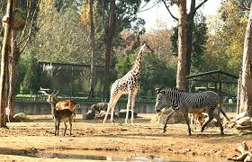
What is this? & What are those?
It’s a ______ & Those are ____
zoo
animals

Slide 16
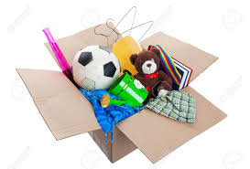
What is this? & What are those?
It’s a ______ & Those are ______
box
Things

Slide 17
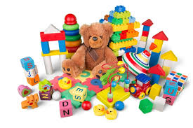
What are these?
Toys

Slide 18
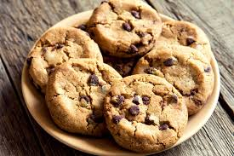
What are those?
Cookies

Slide 19
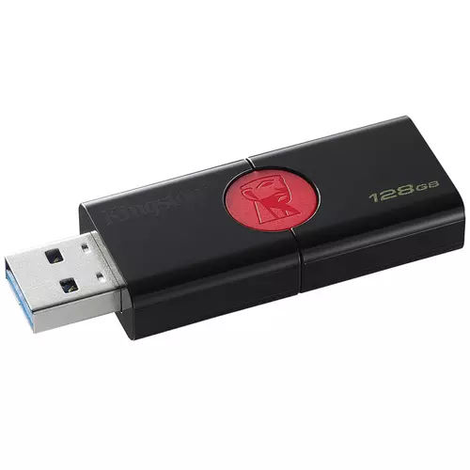
What’s this?
A flash drive

Slide 20
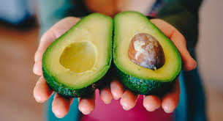
What’s this?
An avocado

Slide 21
Well done!

